Slide 1
BCG MATRIX
Market-Growth/Market-Share Matrix
A strategic planning tool based on the philosophy that a product’s market growth rate and market share are important in determining marketing strategy
Factors determining SBU/product’s position within a matrix
Product-market growth rate
Relative market share

Slide 2
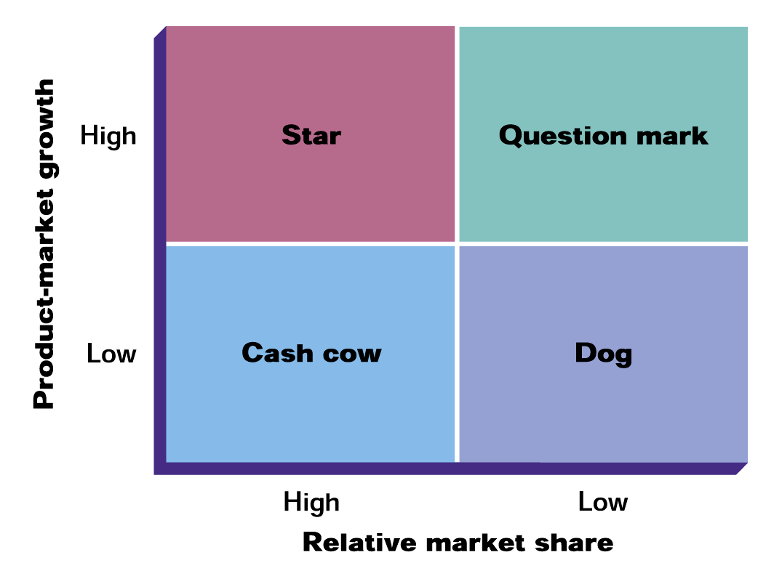
Growth-Share Matrix Developed by the Boston Consulting Group

Slide 3
BCG Classification
Star—high growth market, dominant market share
requires additional resources for continued growth
Cash cow—low growth, dominant market share
generates surplus resources for allocation to other SBUs
Dog—low/declining market, subordinate market share
has diminished prospects and represents a drain on the portfolio
Question mark—high growth market, low market share
represents a high-risk/cost opportunity requiring a large commitment of resources to build market share

